Slide 1
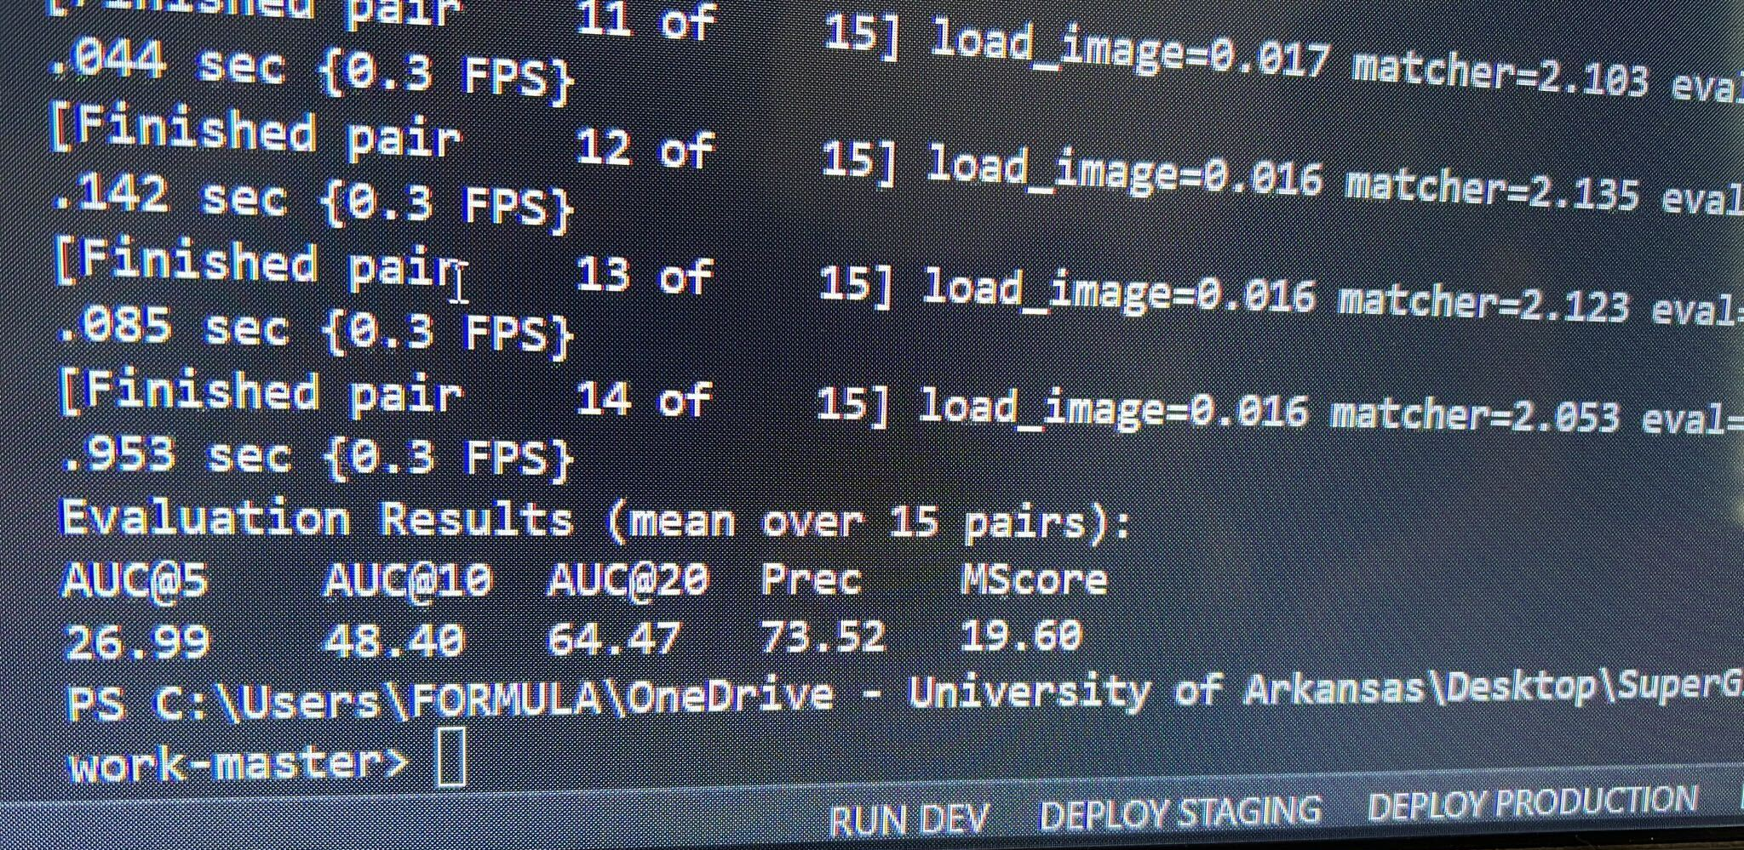
Figure 1

Slide 2
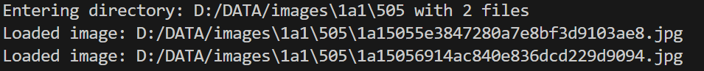
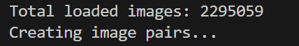
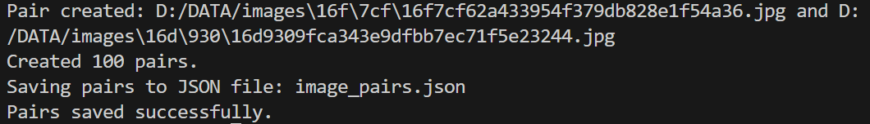
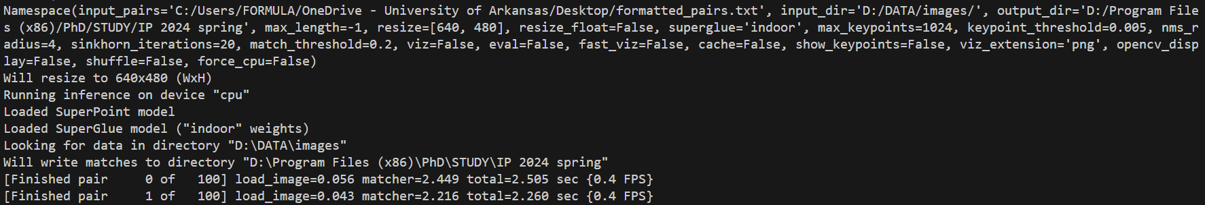
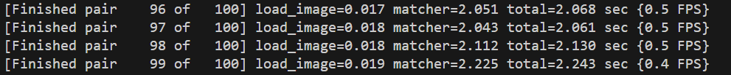
Figure 2

Slide 3
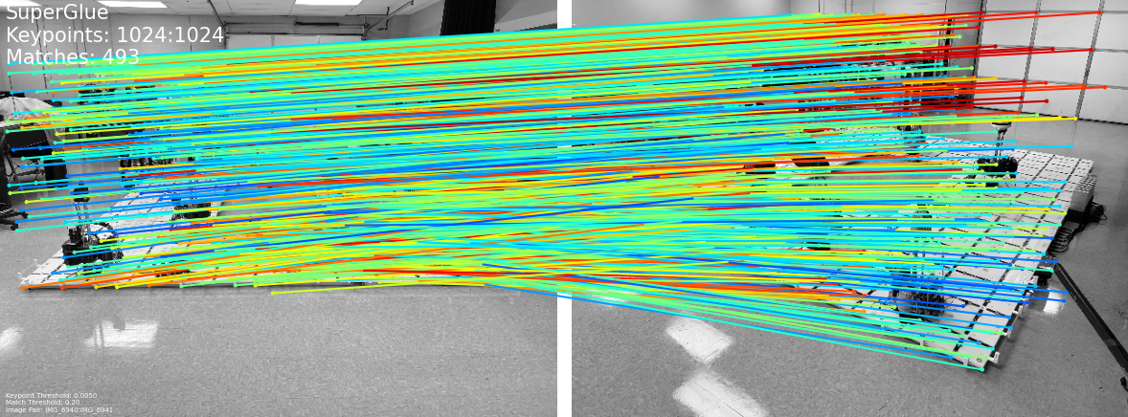
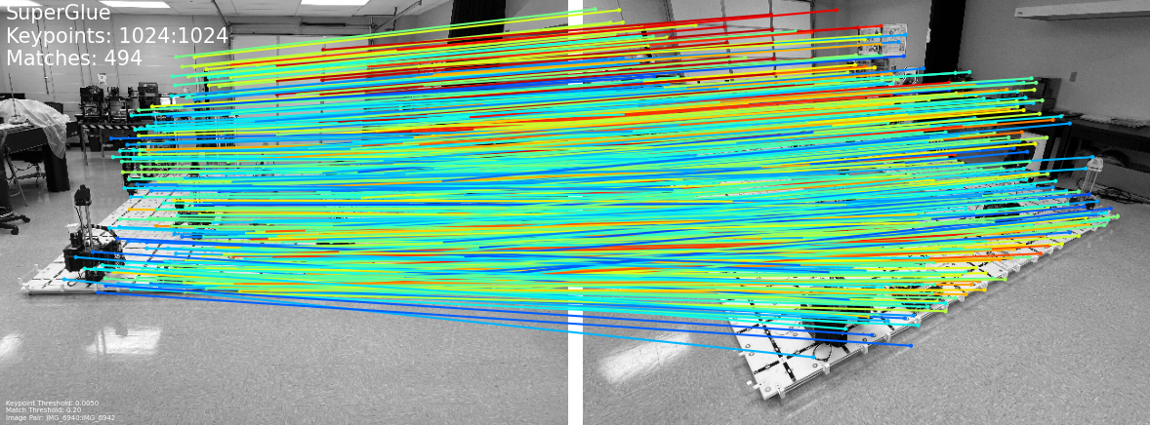
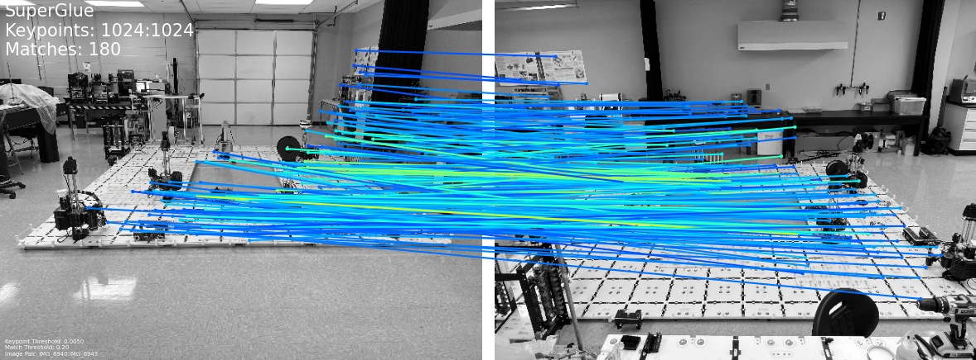
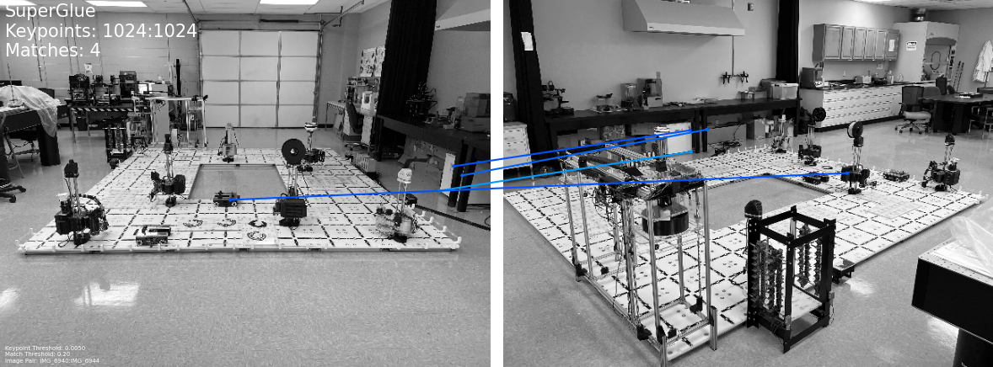
Photos matching
Figure 3: Photos Pairs

Slide 4
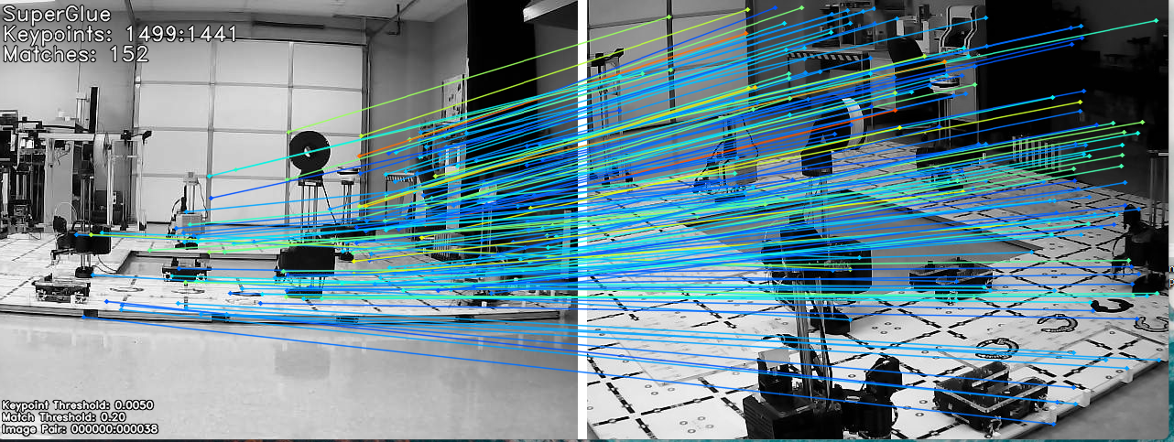
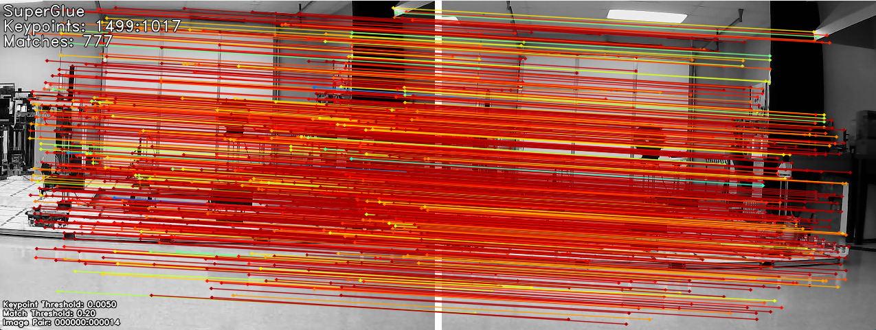
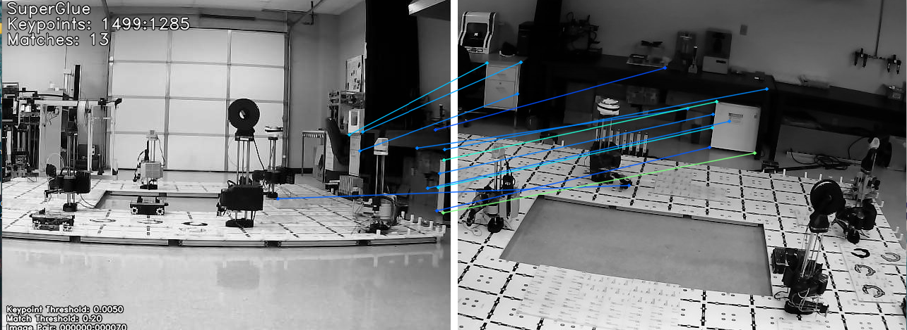
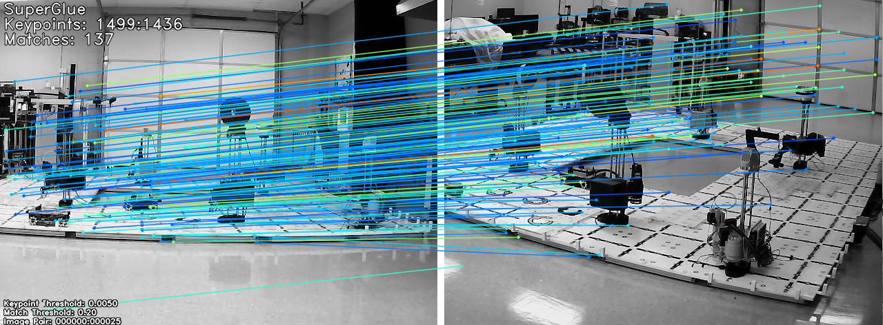
Real-time matching
Figure 4: Implementation of SuperGlue, (a) Original image,
(b) Left corner view of image
Figure 5: Implementation of SuperGlue, (a) Original image,
(b) Frontal view of image
Figure 6: Implementation of SuperGlue, (a) Original image,
(b) Left side view of image
Figure 7: Implementation of SuperGlue, (a) Original image,
(b) Right corner view of image

Slide 5
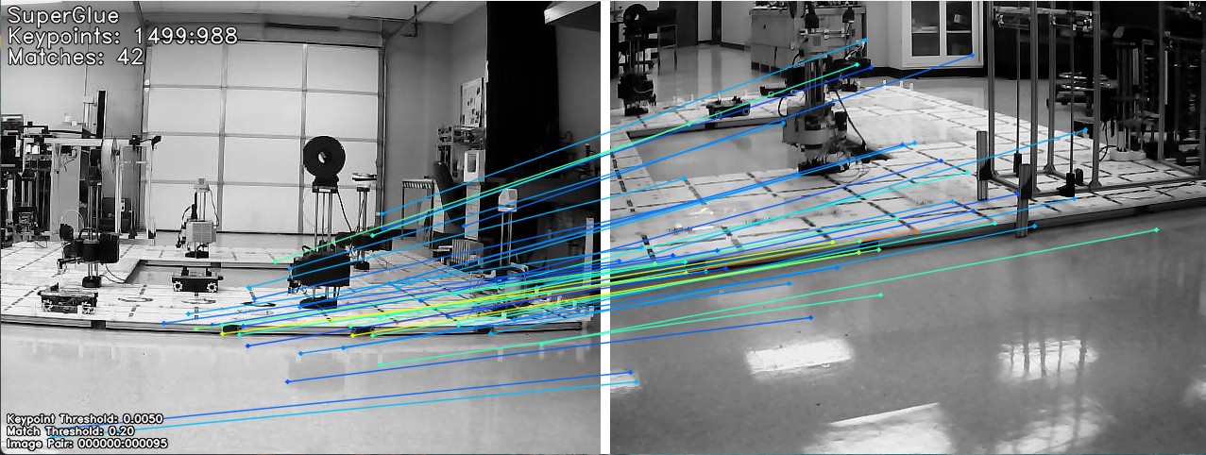
Real-time matching
Figure 8: Implementation of SuperGlue, (a) Original image, (b) Back view of image

